Slide 1
“I am buying the same stuff almost every month. I want to buy it, schedule the delivery time and save the basket to be used the next time.”
Tools: Figma
Project type: Personal

Slide 2
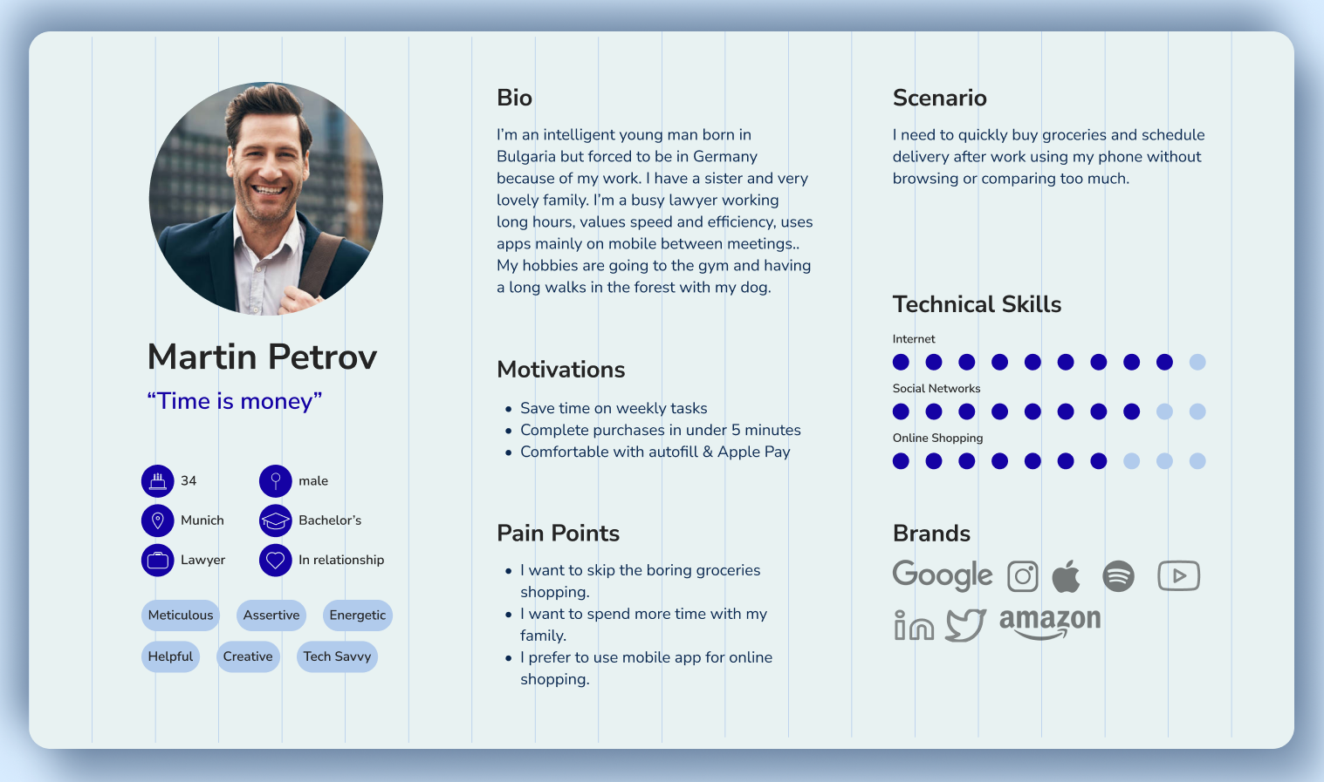
User Persona

Slide 3
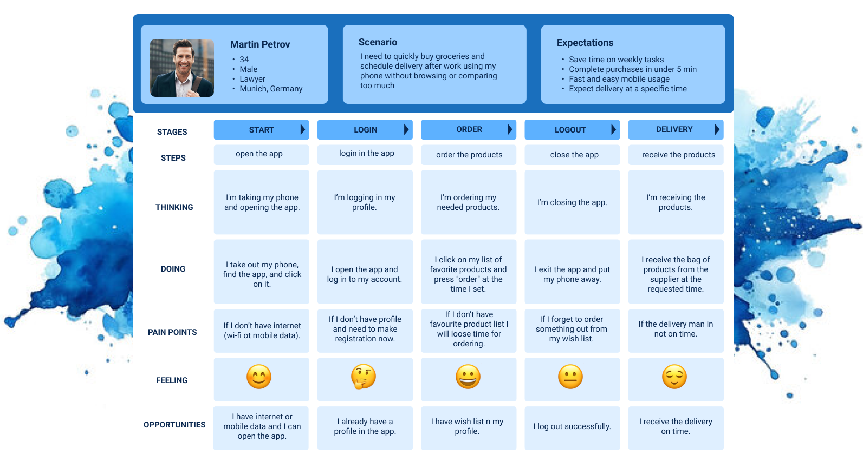
User Journey

Slide 4
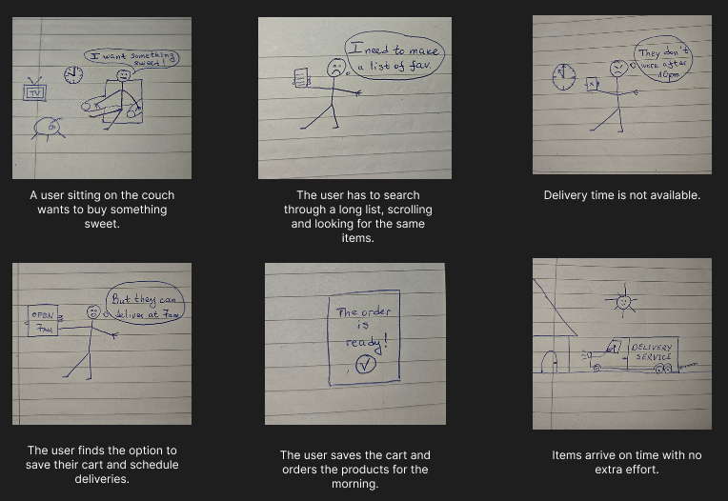
Storyboard

Slide 5
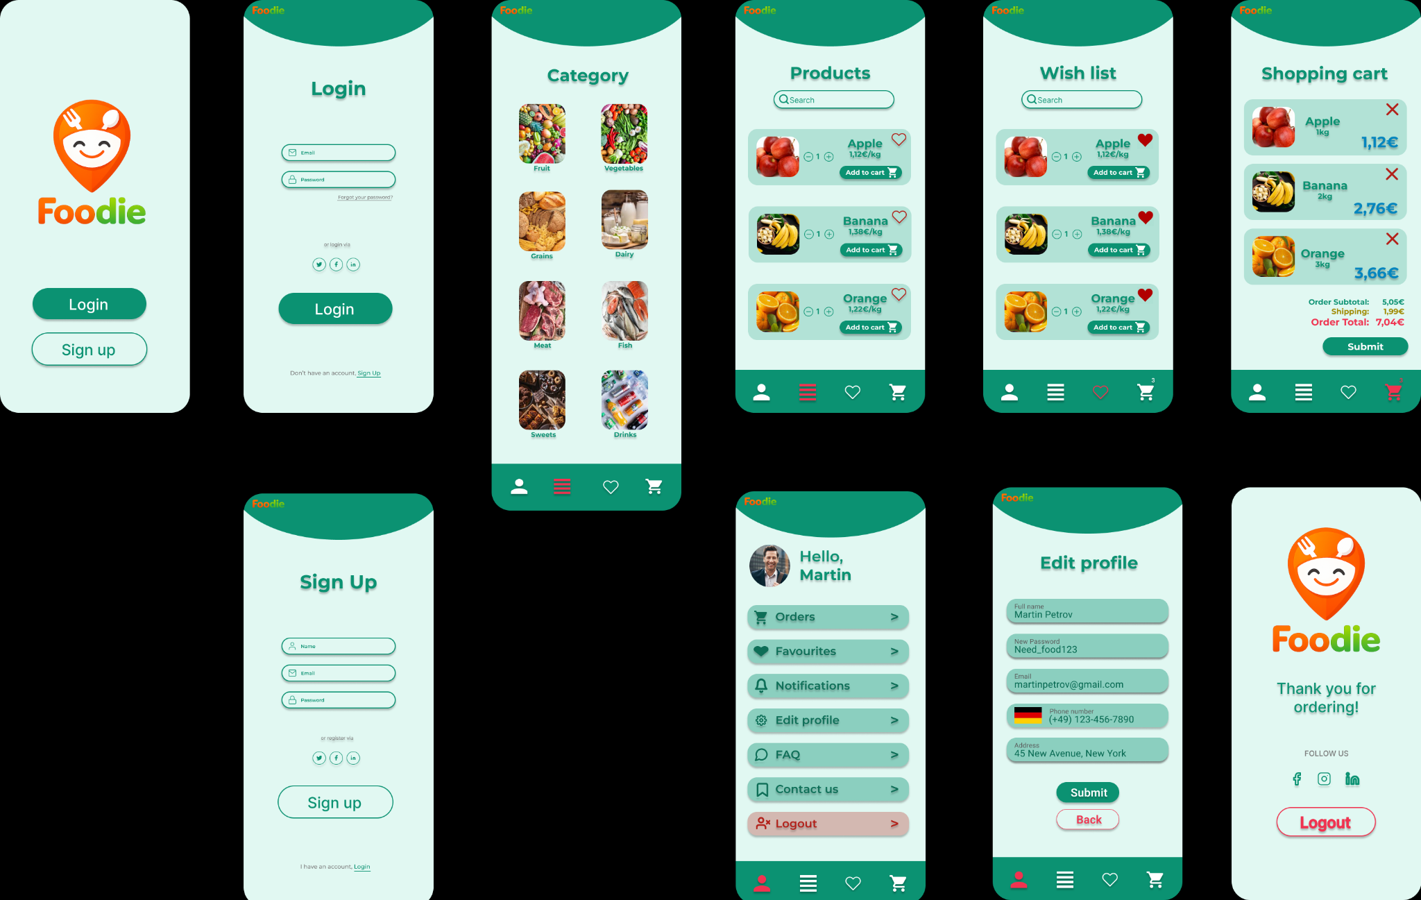
Interactive prototypes

Slide 6
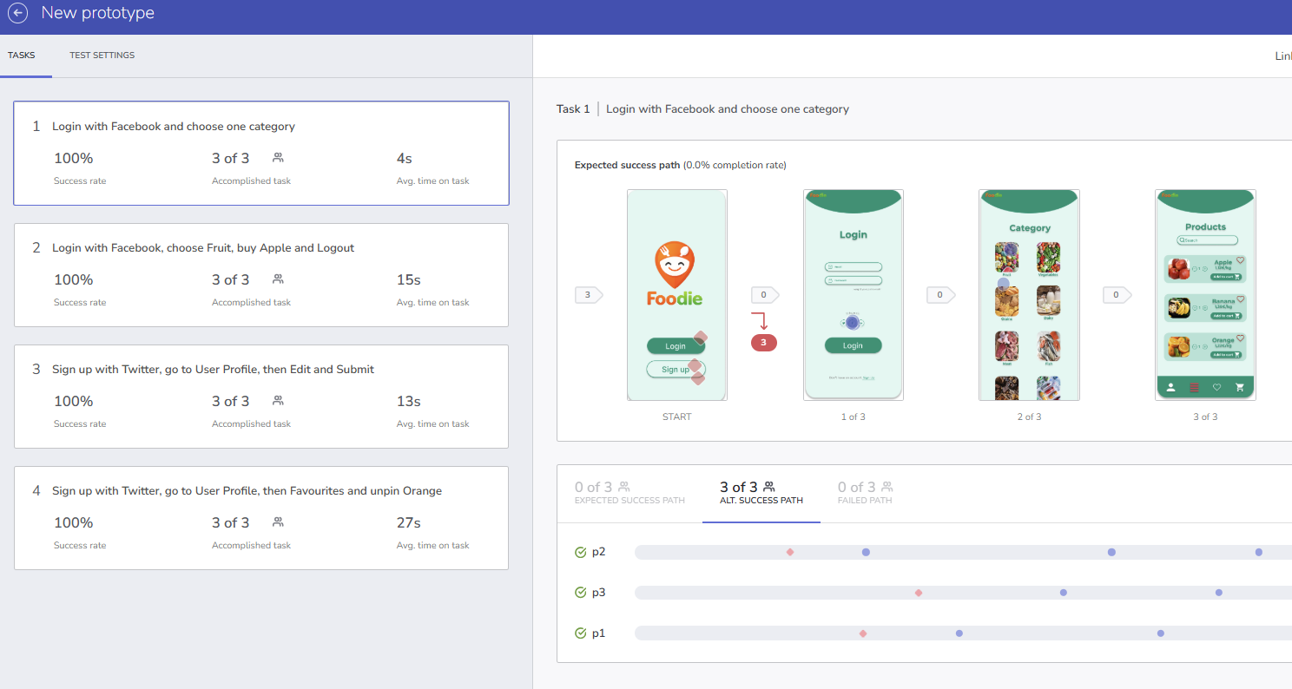
Usability test with Indigo.Design
https://cloud.indigo.design/study/run/hjp8xzvfnbcb/

Slide 7
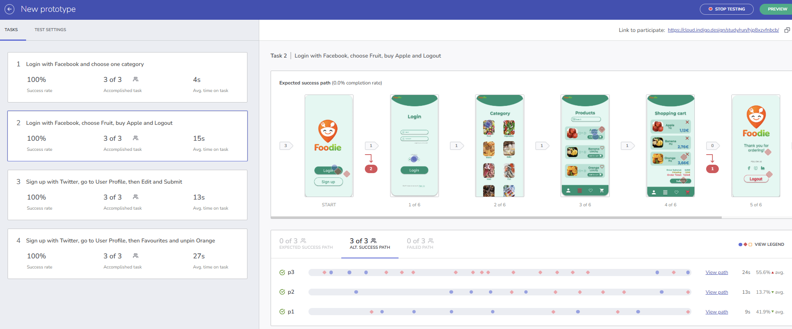

Slide 8
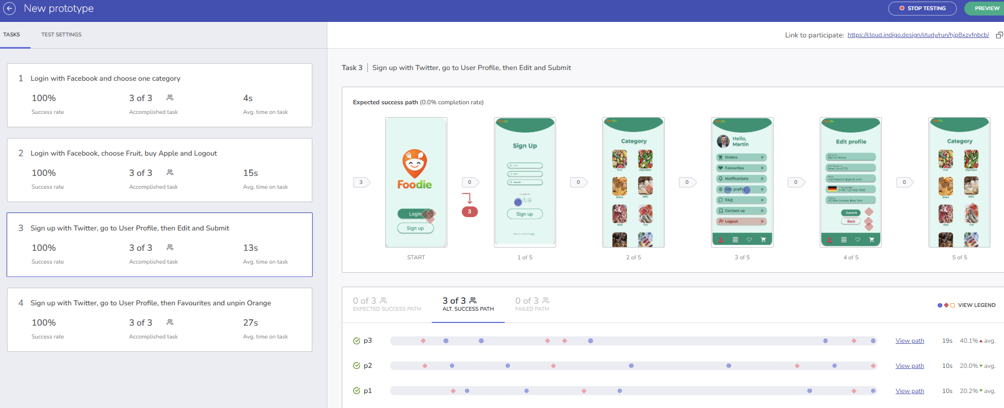

Slide 9
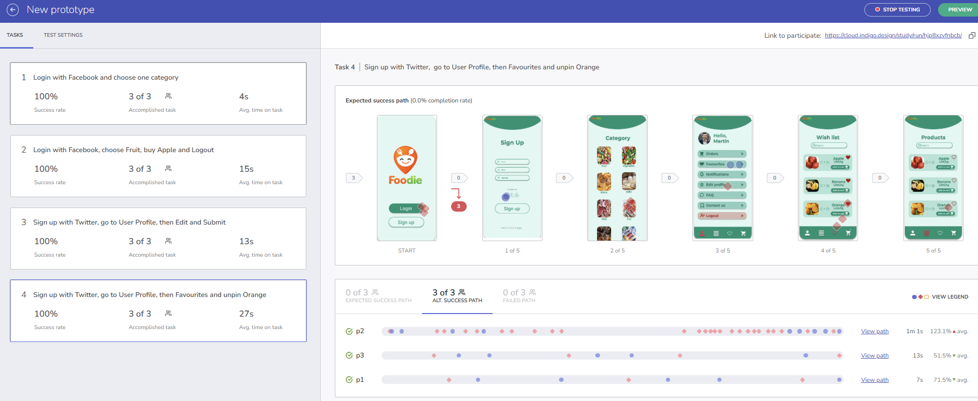

Slide 10
Feedback
Some users showed unexpected interactions on the final confirmation screen. After completing the order, they tapped on the logo or greeting text instead of using the Logout button.
Users were unable to return to the previous screen when they made a mistake or selected the wrong option.
Android users reported that the menu bar was not visible on the Category screen, while iOS users had no navigation issues.
Overall Conclusion
The usability test showed that while the general ordering flow was understandable, there were some navigation and visibility issues that affected user experience, especially on Android devices.

